Slide 1
Diyala University College of Engineering Fourth Year 2012/2013 Computer & Software Engineering Department
Cryptography Algorithms
Chapter 2/Part5
PRESENTED BY
DR. ALI J. ABBOUD

Slide 2
Objectives
History
Mathematical Background
Arithmetic Modulus
Remainder Arithmetic
Factors
Prime and Compound Numbers
Power and base
Laws of Indices
Modular Inverse
Public Key Cryptography
Markel's Knapsack Algorithm
RSA Algorithm

Slide 3
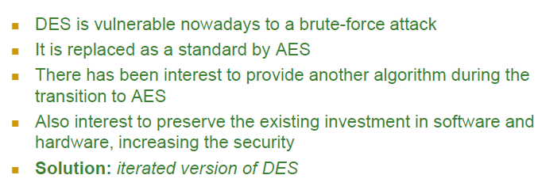
Replacement of DES

Slide 4
Double DES

Slide 5
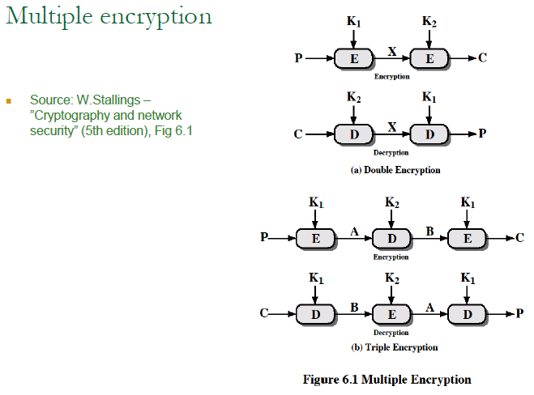
Double DES

Slide 6
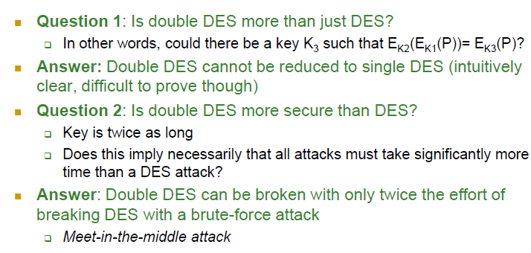
Security of Double DES

Slide 7
Man in the Middle Attacks on the Double DES

Slide 8
Man in the Middle Attacks on the Double DES

Slide 9
Man in the Middle Attacks on the Double DES

Slide 10
Tripple DES

Slide 11
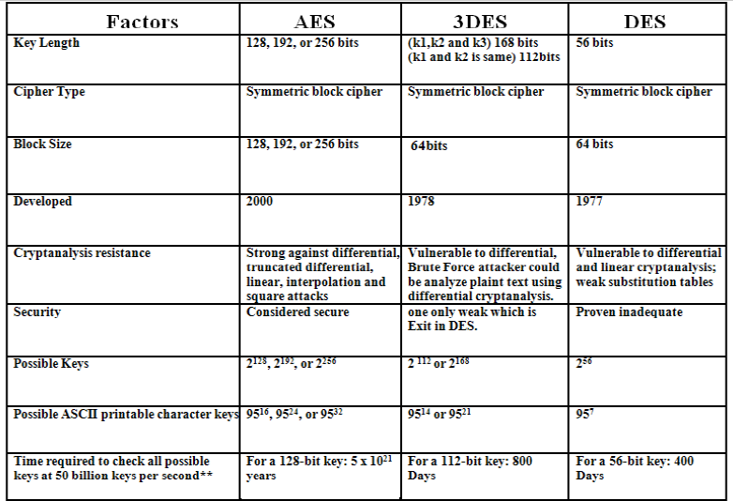
Comparison

Slide 12
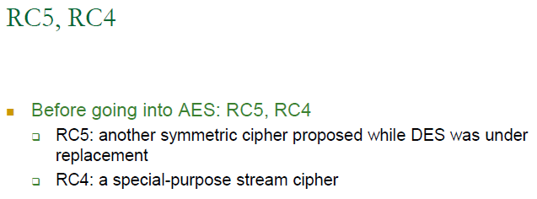
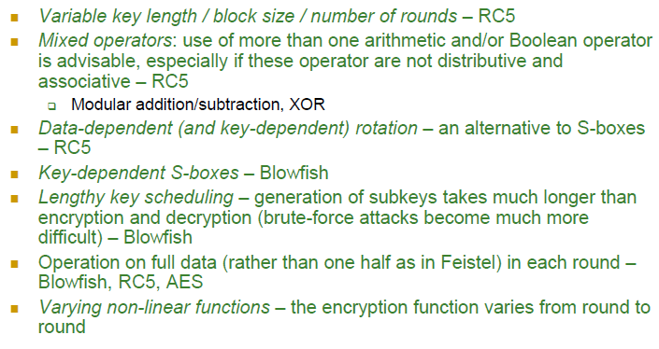
RC 4 and RC5 Algorithms

Slide 13
RC5 Algorithm

Slide 14
RC5 Algorithm

Slide 15
RC5 Algorithm

Slide 16
RC5 Algorithm: Key Expansion

Slide 17
RC5 Algorithm: Key Expansion

Slide 18
RC5 Algorithm: Key Expansion

Slide 19
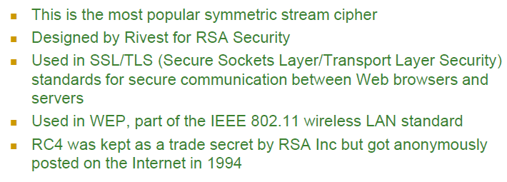
RC4 Stream Cipher

Slide 20
RC4 Stream Cipher Structure

Slide 21
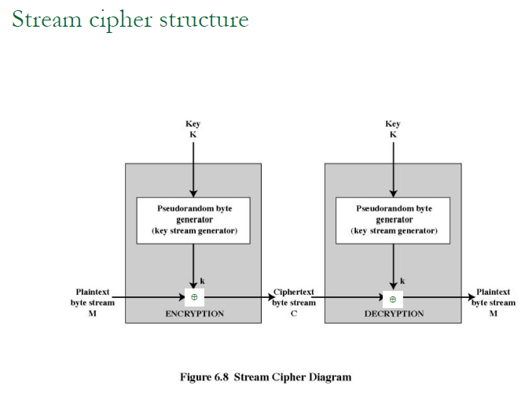
RC4 Stream Cipher Structure

Slide 22
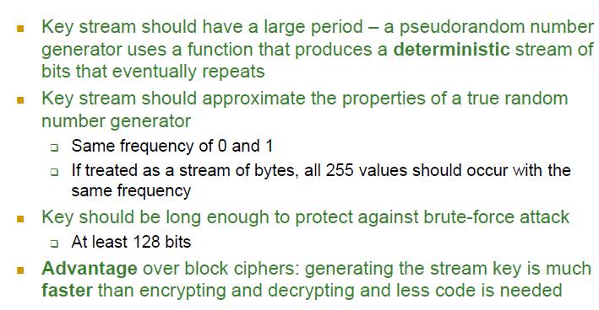
RC4 Stream Cipher Design

Slide 23
RC4 Stream Algorithm

Slide 24
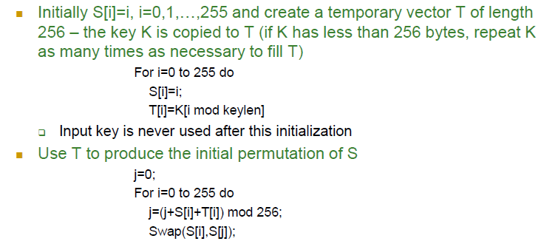
RC4 – initialization of S

Slide 25
RC4 – stream generation

Slide 26
Blowfish Algorithm

Slide 27
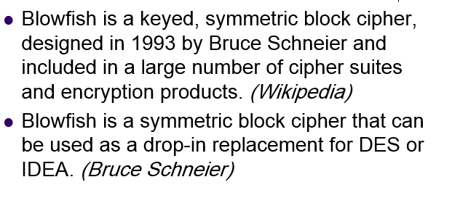
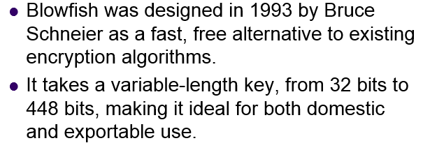
Blowfish Algorithm

Slide 28
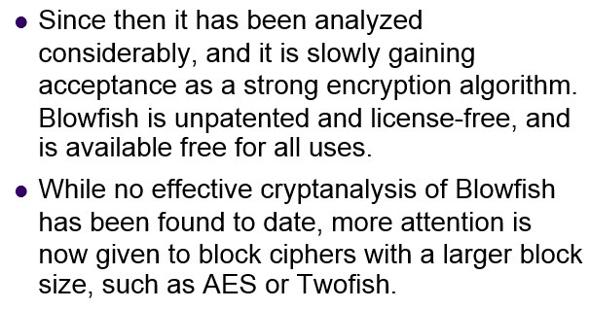
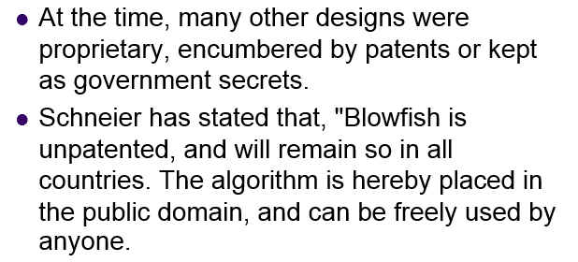
Blowfish Algorithm

Slide 29
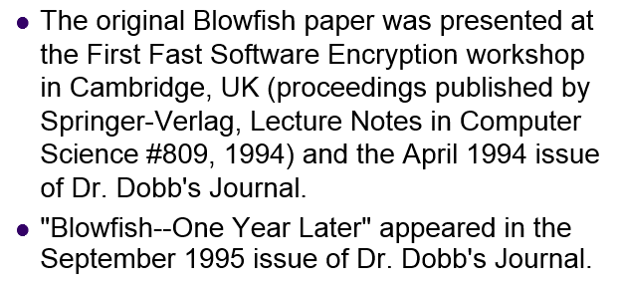
Blowfish Algorithm

Slide 30
Blowfish Algorithm

Slide 31
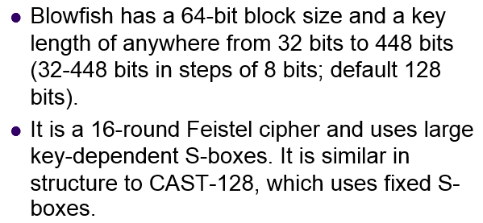
Blowfish Algorithm

Slide 32
Blowfish Algorithm

Slide 33
Blowfish Algorithm

Slide 37
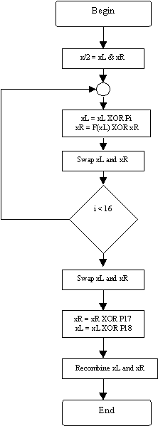

Slide 38
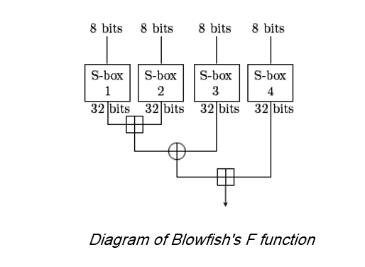

Slide 40
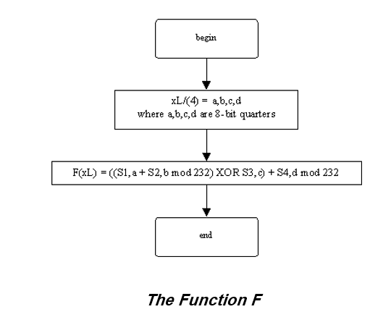

Slide 45
